Slide 1

DATA ANALYTICS & BUSINESS FORECASTING
Which Forecasting Method
Actually Wins, Region by Region?
An Executive Analysis Using NotebookLM to Synthesize Quantitative Accuracy and Qualitative Demand Patterns
N
S
E
W
C
North
South
East
West
Central
Name : Navithanjali M S [24BAD077] · Course - Buisness Intelligence / Section B.tech.AIDS
Notes:
Good morning, everyone. Thank you for joining me for this executive walkthrough of Lab 4, where I used NotebookLM to answer a deceptively simple question: which forecasting method actually wins, region by region?
Here's the business scenario. Our national retailer tested six different forecasting methods — Naive, Simple Exponential Smoothing, Holt Linear, Holt-Winters, ARIMA, and Prophet — against five years of historical sales data across five regions: North, South, East, West, and Central.
But raw accuracy numbers only tell half the story. So alongside the accuracy data, our regional analysts also logged qualitative notes describing each region's actual demand behavior — things like seasonality, growth trends, and volatility.
My objective in this lab was to bring both of those data sources into NotebookLM, let it synthesize the numbers with the narrative, and produce a set of regional forecasting recommendations that are not just statistically accurate, but operationally explainable to this leadership team.
Over the next few slides, I'll walk you through exactly how I set that up, what I asked the AI, what it found, and — just as importantly — where I had to challenge its output rather than take it at face value.
1

Slide 2
WORKFLOW & SETUP IN NOTEBOOKLM
Uploading Sources & Dual-Source Synthesis Setup
📊
SOURCE
🗒
SOURCE
Upload
Sources
Prompt
NotebookLM
Cross-Reference
Data
Generate
Insight
forecast_method_
accuracy.csv
region_notes.csv
›
›
›
MAPE error rate for 6 forecasting methods across all 5 regions
Analyst commentary describing each region's real demand pattern
WHY TWO SOURCES?
Accuracy numbers alone don't tell leadership why a method works. Pairing the quantitative error rates with the analysts' qualitative demand notes forces NotebookLM to reason about causation, not just ranking — producing recommendations that are operationally explainable, not just statistically correct.
GROUNDING PROMPT: “Using both uploaded files, explain why the best-performing method in each region matches or conflicts with the analyst's description of that region's demand pattern.”
Notes:
Let's talk about how I actually set this up in NotebookLM, because the setup matters as much as the prompting.
I uploaded two sources. The first is forecast_method_accuracy.csv, which contains the error rate — measured in MAPE, or mean absolute percentage error — for all six forecasting methods, in every one of our five regions. Lower error means a more accurate forecast.
The second source is region_notes.csv. This is qualitative. It's the on-the-ground commentary from our regional analysts describing what demand actually looks like in their region — is it seasonal, is it flat, is it trending, is it volatile.
The reason I uploaded both, instead of just asking NotebookLM to rank the numbers, is that accuracy alone doesn't tell leadership why a method works. A model can win on paper and still be the wrong long-term choice if it doesn't match the underlying demand behavior.
So my first grounding prompt explicitly asked NotebookLM to reason across both files together — to explain why the top-performing method in each region either matched or conflicted with what the analyst notes described. That dual-source instruction is what shaped every answer that followed.
2

Slide 3
TASK 2 WALKTHROUGH
Region-by-Region Breakdown: Winner vs. Demand Pattern
Region | Winning Method | Error | Demand Pattern | Fit
North | Holt-Winters | 7.1% | Strong seasonality, Q4 spikes | Expected
South | Prophet | 9.2% | Non-linear monsoon surges | Notable
East | Naive | 5.1% | Flat, stable, no trend | Notable
West | Prophet | 11.2% | Steady growth + seasonality | Expected
Central | Holt-Winters | 6.8% | Quarterly seasonality + growth | Expected
PROMPT USED: “For each region, identify the forecasting method with the lowest error rate, then explain whether that result is consistent with the analyst's description of the region's demand pattern.”
North, Central & West behave as expected — South and East are the outliers worth a closer look, covered next.
Notes:
This is the core analytical slide, so let's walk through it region by region.
In the North, Holt-Winters wins clearly at 7.1% error. That makes total sense — the analyst notes describe strong seasonal fluctuation with predictable Q4 holiday spikes, and Holt-Winters is purpose-built to capture both trend and repeating seasonal cycles. The model and the story agree.
Central tells a very similar tale. Holt-Winters again wins, at 6.8% error, and the notes describe strong quarterly seasonality layered on top of moderate growth. Again, expected alignment between the math and the narrative.
West is a little more interesting: Prophet edges out ARIMA, 11.2% versus 11.5%. The region shows steady upward growth with moderate seasonal peaks — exactly the kind of trend-plus-seasonality pattern Prophet was designed to decompose.
Now here's where it gets genuinely interesting, and where I want you to pay close attention, because these next two regions are the ones I dig into on the following slides. In the South, Prophet wins by a wide margin — 9.2% versus the next-best ARIMA at 15.1%. And in the East, the simplest method on the list, Naive, actually wins outright at 5.1% error, beating every sophisticated model we tested.
Those two results — South and East — are the ones NotebookLM flagged as most worth explaining to this leadership team, and that's exactly where I'm headed next.
3

Slide 4
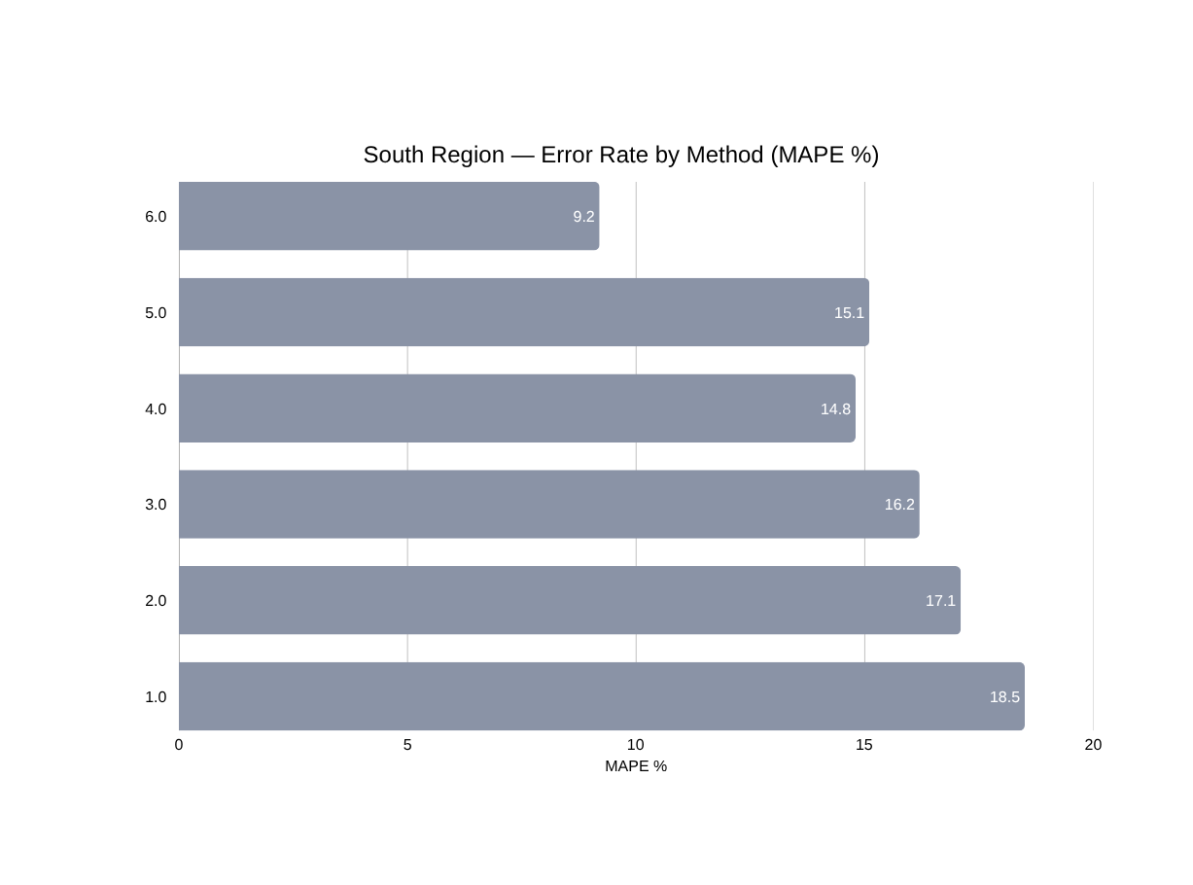
TASK 3 WALKTHROUGH
The Surprising Winner: South Region & Prophet vs. Weather Surges
Error rates: Naive 18.5% · SES 17.1% · Holt Linear 16.2% · Holt-Winters 14.8% · ARIMA 15.1% · Prophet 9.2%
Analyst note: unpredictable, weather-driven monsoon surges creating non-linear spikes and holiday effects
Why Prophet wins: automatic changepoint detection absorbs abrupt, irregular surges that trend-and-seasonality-only models smooth over
Business takeaway: the most volatile region needs the most flexible model — not necessarily the most complex-sounding one
PROMPT USED: For any region where the best-performing method surprises you, explain using only the provided sources why that method might be winning there.
Notes:
Let's zoom in on the South region, because this is the result that most surprised me when I first saw it, and it's exactly the kind of finding a good AI synthesis tool should surface.
On paper, every method in the South performs worse than in any other region — even the winner, Prophet, has a 9.2% error rate, which is higher than the winning error rate everywhere else. That tells us something on its own: the South is simply a harder region to forecast.
But look at the gap. Prophet beats the next-best method, ARIMA, by nearly six full percentage points — 9.2% versus 15.1%. That's not a marginal win, that's a decisive one.
I asked NotebookLM to explain that gap specifically, using the analyst notes. The South's notes describe unpredictable, weather-driven monsoon surges — non-linear spikes tied to holidays and weather events, not a clean repeating calendar pattern.
Here's the business reasoning: methods like Holt-Winters and ARIMA assume a relatively stable, repeating structure to seasonality. When demand spikes are irregular and event-driven rather than calendar-driven, those models smooth right through the surge and miss it. Prophet, on the other hand, is built with automatic changepoint detection — it's designed to notice abrupt shifts in the trend and adjust rather than average them away.
The executive takeaway here is simple: our most volatile, most chaotic region needs our most adaptive model — not necessarily the one that looks most sophisticated in a vendor brochure, but the one engineered specifically for irregular shocks.
4

Slide 5
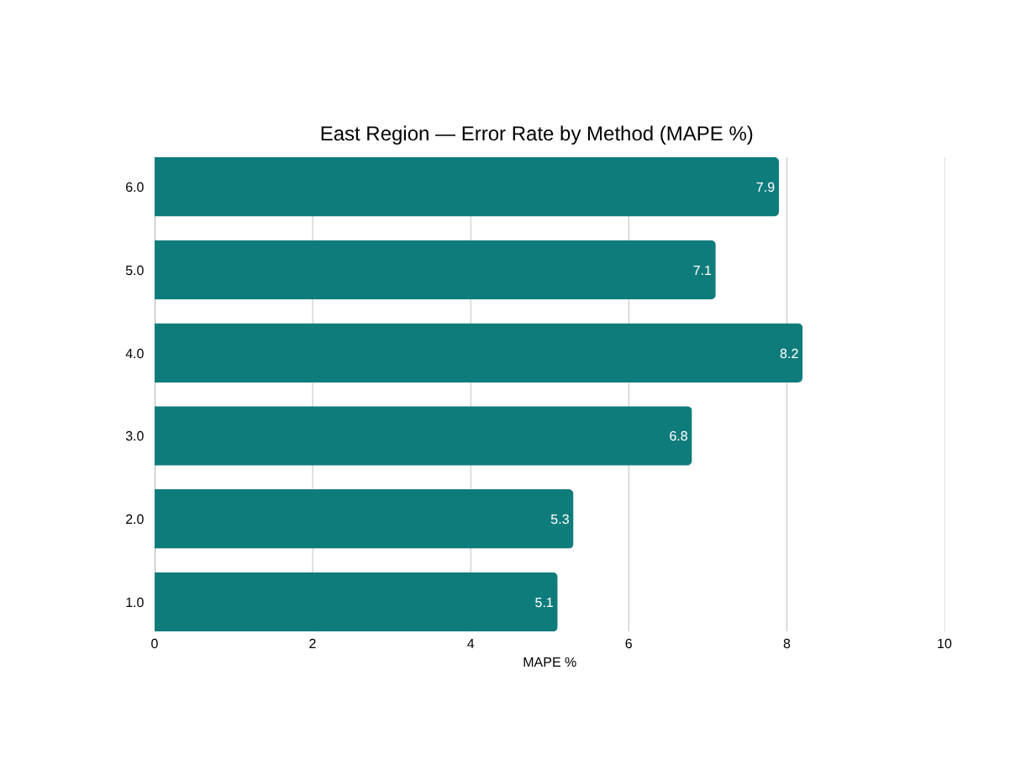
TASK 4 WALKTHROUGH
Simple Wins: East Region, Overfitting & Model-Complexity Fit
Error rates: Naive 5.1% · SES 5.3% · Holt Linear 6.8% · Holt-Winters 8.2% · ARIMA 7.1% · Prophet 7.9%
Analyst note: very stable, flat demand with minor random variation, no significant trend or seasonality
Finding: every added layer of model complexity increases error in this region — a textbook overfitting signature
Business takeaway: match model complexity to demand complexity — sophistication is not automatically accuracy
PROMPT USED: .
"Identify the one region where the simplest methods (naive or simple exponential smoothing) actually perform competitively — and explain, from the analyst note, why added complexity isn't paying off there.
Notes:
Now let's flip to the opposite lesson, in the East region, because this one is arguably more important for how we operate day to day.
In the East, the simplest possible forecasting method — Naive, which essentially just carries last period's value forward — wins outright at 5.1% error. Simple Exponential Smoothing is a close second at 5.3%. And notice the pattern as you move down the list: Holt Linear, Holt-Winters, ARIMA, and Prophet all perform worse, not better, as they get more sophisticated.
Why? The analyst notes for the East describe very stable, flat demand with only minor random variation — no meaningful trend, no seasonality to speak of.
When I asked NotebookLM to explain this pattern, it correctly identified this as a textbook overfitting scenario. The more complex models are built to detect trend and seasonal structure. When that structure genuinely doesn't exist in the data, those models don't just fail to add value — they actively manufacture false patterns out of random noise, and that noise-chasing behavior increases their error.
The executive takeaway is one I'd like this room to remember: more advanced does not mean more accurate. Model selection should always be driven by the actual complexity of the demand pattern, not by which tool sounds the most impressive. In a flat, stable region like the East, running a lightweight Naive or SES model isn't just adequate — it's measurably the better choice, and it's cheaper and faster to maintain.
5

Slide 6
TASK 5 DELIVERABLE
Executive Summary: Regional Default Forecasting Methods
Region | Default Method | Error | Business Rationale
North | Holt-Winters | 7.1% | Captures strong, predictable Q4 seasonality
South | Prophet | 9.2% | Adapts to irregular, weather-driven demand shocks
East | Naive | 5.1% | Flat demand needs no complexity; avoids overfitting
West | Prophet | 11.2% | Balances steady growth trend with seasonal peaks
Central | Holt-Winters | 6.8% | Matches quarterly seasonality plus moderate growth
We are not choosing one company-wide forecasting standard — we are matching model sophistication to the actual shape of regional demand. That region-by-region discipline is what drives the accuracy gains in this table.
Notes:
Let's bring this together into what leadership actually needs: a default method per region that our forecasting team can operationalize starting next quarter.
North defaults to Holt-Winters, because the region's defining feature is predictable, repeating seasonality around the holidays.
South defaults to Prophet, because it's the only method flexible enough to absorb irregular, weather-driven surges without leadership having to intervene and re-forecast manually every time there's a surprise.
East defaults to Naive — and I want to underline that this is a considered recommendation, not a shortcut. It is the mathematically best-performing option and the cheapest to run.
West defaults to Prophet, since it's carrying both a genuine growth trend and moderate seasonal peaks, and Prophet handles that combination slightly better than ARIMA.
And Central defaults to Holt-Winters, for the same reason as North: strong, structured seasonality that a dedicated seasonal model captures well.
The unifying principle across all five recommendations is this: we are not choosing one company-wide forecasting standard. We are matching model sophistication to the actual shape of regional demand, and that region-by-region discipline is what's driving the accuracy gains you see in this table.
6

Slide 7
TASK 6 DELIVERABLE
Critique of NotebookLM: Insight Added vs. Numbers Restated
WHERE IT ADDED REAL INSIGHT
WHERE IT JUST RESTATED THE DATA
Connected quantitative winners to qualitative causes — e.g., Prophet's changepoint strength → South's weather surges
Correctly diagnosed overfitting behavior in the East without being explicitly told the term
Synthesized one consistent, defensible decision rule across all five regions rather than five isolated answers
First-draft answers sometimes just re-listed the lowest MAPE value per region with no unprompted reasoning
Needed explicit follow-up prompting to compare methods within a region rather than just report the winner
Did not proactively flag data-quality caveats (e.g., a 5-year sample) unless directly asked
“The value NotebookLM added came from the questions I asked it — not from the tool working autonomously.”
Notes:
Finally, I want to close with an honest critique of the tool itself, because part of this lab is evaluating NotebookLM, not just trusting it.
Where it genuinely added value: once I gave it explicit dual-source prompts, it did real synthesis. It connected Prophet's technical strength in changepoint detection to the South's weather-driven demand shocks. It independently recognized the overfitting pattern in the East, even though I never used that word in my prompt — it inferred the concept from the data. And it produced one coherent decision framework across all five regions instead of five disconnected answers.
Where it fell short: left to its own devices, its first-pass answers tended to just restate the lowest error number per region without explaining why. I had to explicitly prompt it to compare methods and reference the qualitative notes before it did any real reasoning. It also didn't proactively raise caveats — for example, five years of data is a relatively short history for validating a seasonal model, and I had to ask about that limitation directly rather than have it surface unprompted.
My overall verdict: NotebookLM is a strong synthesis engine when it's directed with specific, cross-source prompts, but it is not yet a substitute for a human analyst's judgment about what's worth flagging. The value it added in this lab came from the questions I asked it, not from the tool working autonomously — which is exactly the kind of finding I'd want any of you to keep in mind before handing a tool like this a fully autonomous role in our forecasting process.
That concludes my walkthrough. Thank you.
7

